Slide 1
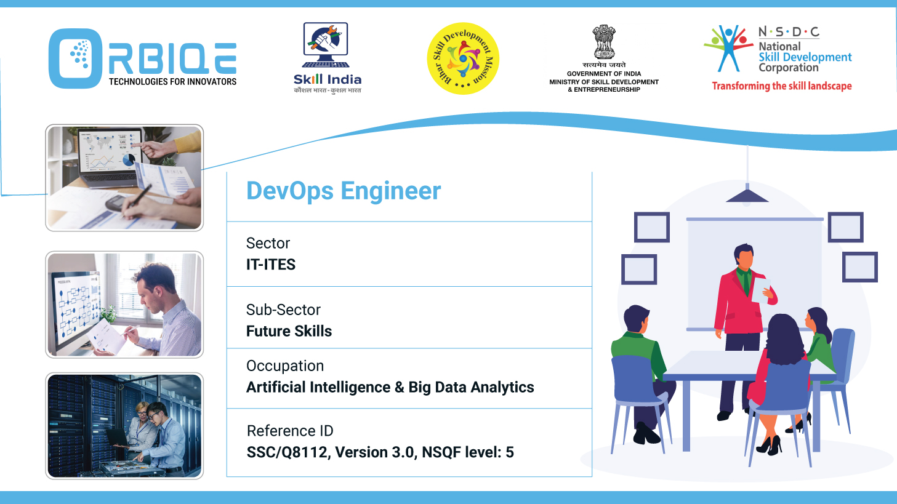
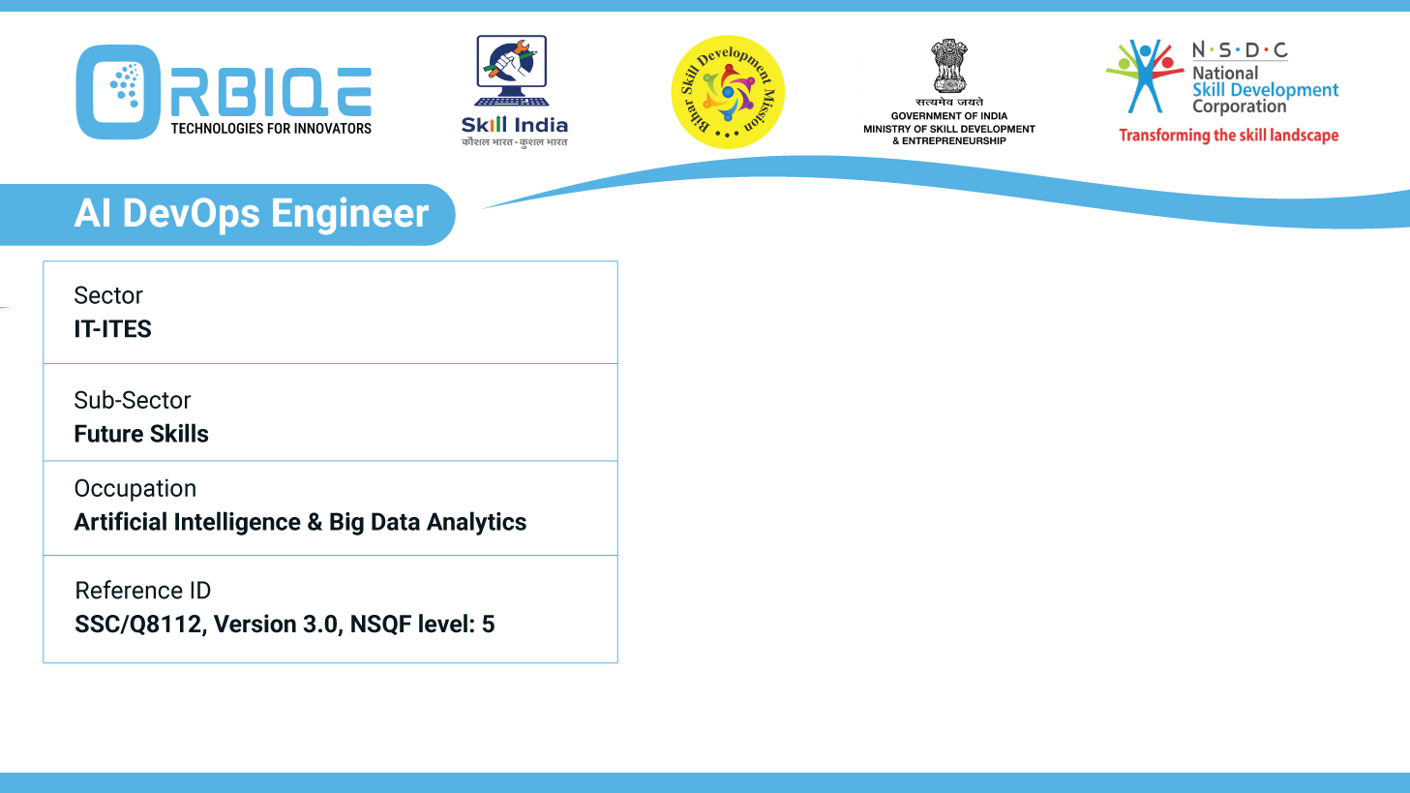
Name- Krishna Kant Dubey

Slide 2

Issue Identification and Counteraction : Proactive Database Management

Slide 3
Agenda
Develop procedures to identify and counter issues with databases, fostering proactive management and issue resolution

Slide 4
Best practices, automation, and diagnostic strategies
Issue Identification Procedures
Issue Countermeasures & Resolution Procedures

Slide 5
Performance Monitoring
Metrics to Track: Query latency, CPU usage, memory consumption, disk I/O, connection pool saturation.
Tools: SolarWinds DPA, Prometheus, SQL Server Profiler,
pg_stat_statements.
Automation: Set up alerts for threshold breaches and anomaly detection using AI models

Slide 6
Health Checks & Diagnostics
Routine Checks:
DBCC CHECKDB (MSSQLSERVER) for corruption
ANALYZE and EXPLAIN(PostgresSQL)for query plans.
Log Analysis
Sources: Error logs, slow query logs, transaction logs.
Tools: ELK Stack (Elasticsearch, Logstash, Kibana), Fluentd.
AI Enhancement: Use NLP models to classify and prioritize log anomalies.

Slide 7
Health Checks & Diagnostics
Security Audits
Checks: Unauthorized access, privilege escalation, failed login attempts.
Tools: IBM Guardium, Microsoft Defender for Cloud.
Automation: Schedule audits and generate compliance reports

Slide 8
Issue Countermeasures & Resolution Procedures
Query Optimization
Action: Rewrite inefficient queries, add indexes, refactor joins.
Tools: SQLFlash, AI2SQL, Oracle Optimizer.
Automation: Use AI to suggest and apply query improvements.
Index Tuning
Action: Rebuild or reorganize fragmented indexes.
Automation: Trigger based on fragmentation thresholds (e.g., >30%)

Slide 9
Issue Countermeasures & Resolution Procedures
Data Cleanup
Action: Remove duplicates, fix nulls, enforce referential integrity.
Tools: Talend, Apache NiFi, custom Python scripts.
Automation: Schedule ETL jobs for routine cleansing.
Backup & Restore
Action: Restore from last known good state in case of corruption.
Automation: Validate backups regularly and simulate restores

Slide 10
Issue Countermeasures & Resolution Procedures
Scaling & Resource Allocation
Action: Adjust memory, CPU, and storage based on usage.
Tools: AWS RDS Auto Scaling, Azure SQL Elastic Pools.
Automation: Use predictive models to forecast and allocate resources.

Slide 11
Thank You

